Slide 1
Keywords and Identifiers

Slide 2
Keywords
Keywords are predefined, reserved words used in Python programming that have special meanings to the compiler.
We cannot use a keyword as a variable name, function name, or any other identifier. They are used to define the syntax and structure of the Python language.
All the keywords except True, False and None are in lowercase and they must be written as they are.

Slide 3
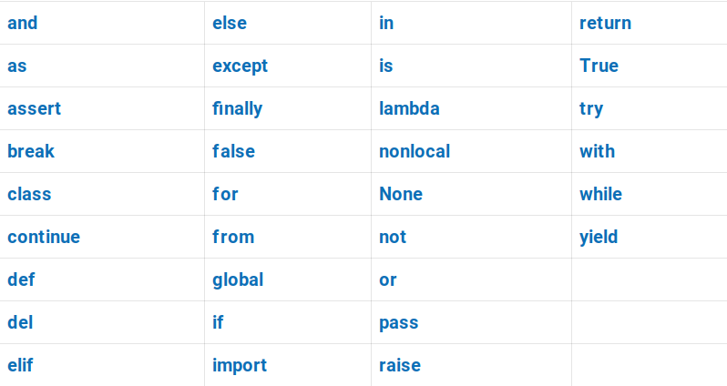

Slide 4
Identifiers
Identifiers are the name given to variables, classes, methods, etc. Example,
language = 'Python’
Here, language is a variable (an identifier) which holds the value 'Python'.
We cannot use keywords as variable names as they are reserved names that are built-in to Python. Example,
continue = 'Python’
The above code is wrong because we have used continue as a variable name.

Slide 5
Rules for Naming an Identifier
Identifiers cannot be a keyword.
Identifiers are case-sensitive.
It can have a sequence of letters and digits. However, it must begin with a letter or _. The first letter of an identifier cannot be a digit.
It's a convention to start an identifier with a letter rather _.
Whitespaces are not allowed.
We cannot use special symbols like !, @, #, $, and so on.

Slide 6
